Slide 1

MACHINE LEARNING ADA BOOST ALGORITHM

Slide 2
What is Ada Boost Algorithm?
AdaBoost (Adaptive Boosting) is an ensemble learning method
All weak models are combined to create a strong model
It trains by taking datapoints that were misclassified in previous round
This adaptation makes it effective for classification tasks

Slide 3
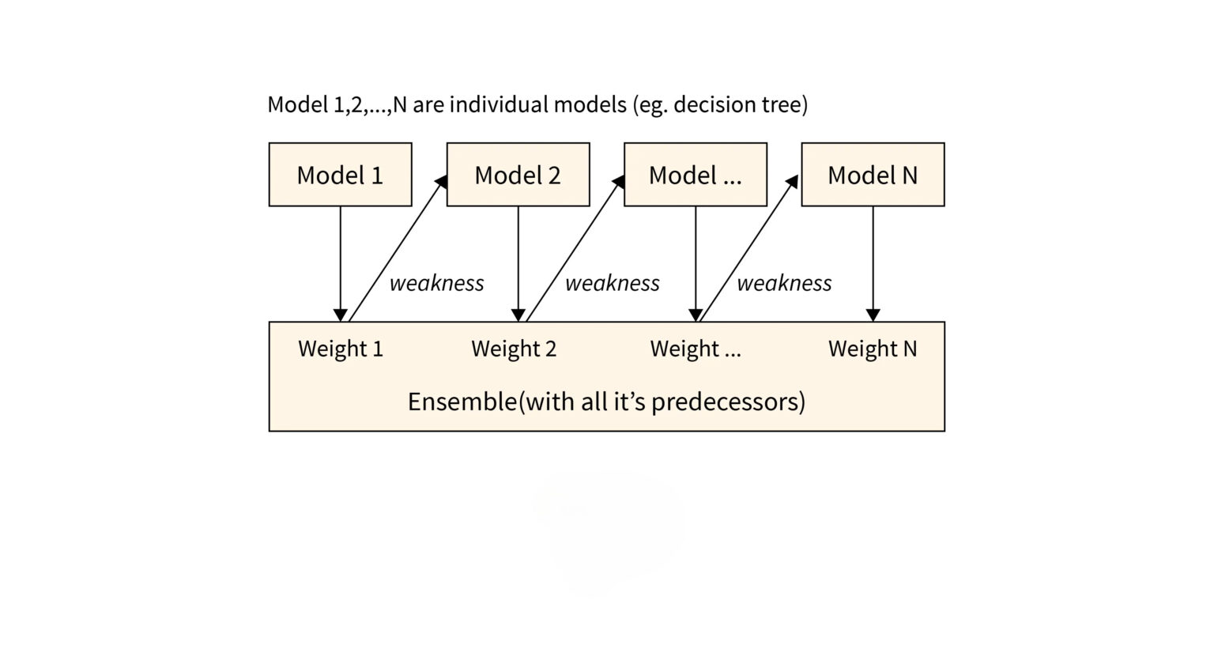
The algorithm fetches input from the dataset and previously misclassified data to create a new model. This repeats to create n-number of models

Slide 4
How Does Ada Boost Work?
Initialize Weight: equal weights are assigned to all the data points
Train Weak Learner: first weak learner datasets are trained
Calculate Errors: based on the sample that weak learner misclassified
Adjust Weights: increases the weight of misclassified sample
Iterate: train new weak learner focusing misclassified samples
Final Model: accuracy driven training creates strong model

Slide 5
Advantages of Ada Boost
Improved Accuracy
Error Adaptability
Easy to Implement
Handles Imbalance Datasets

Slide 6
Disadvantage of Ada Boost
Sensitive to Noisy Data
Intensive Computation
Over fitting

